Slide 1

VASSAR ANALYTICS
Super-Mart Case Study
Presented By :
Rishabh Raja

Slide 2
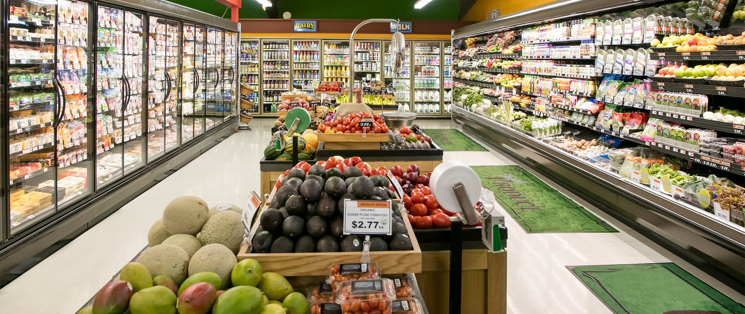

Business Understanding
Overview
Objective
Dataset

Slide 3
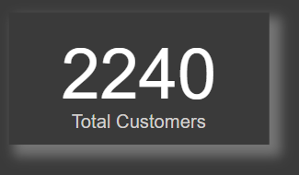
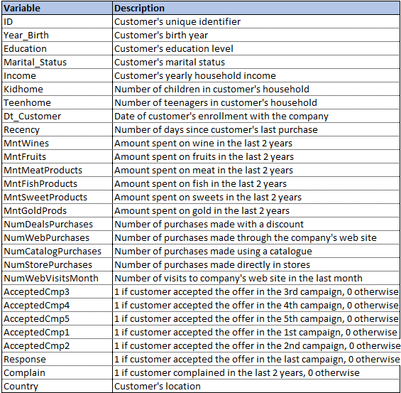
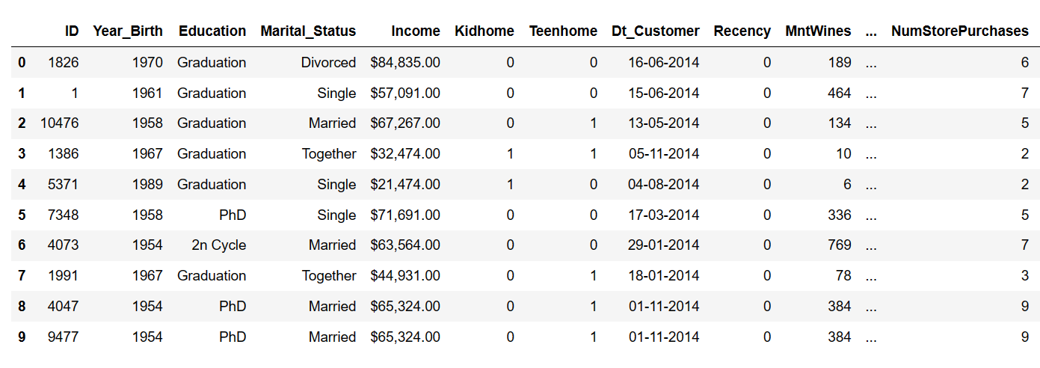
Data Overview
Shape
Sample Records
Type of Data

Slide 4


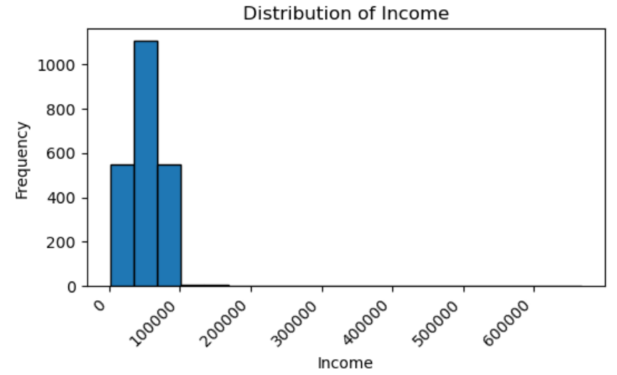
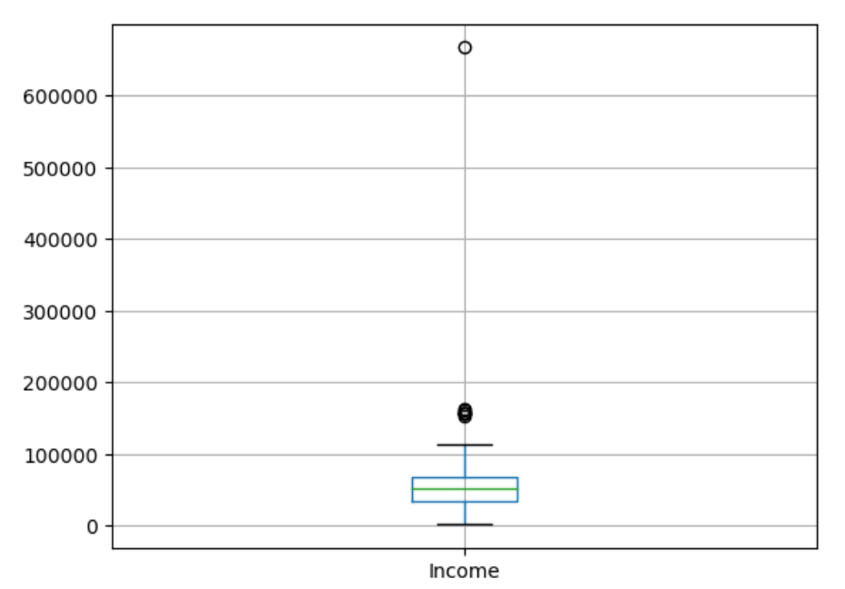
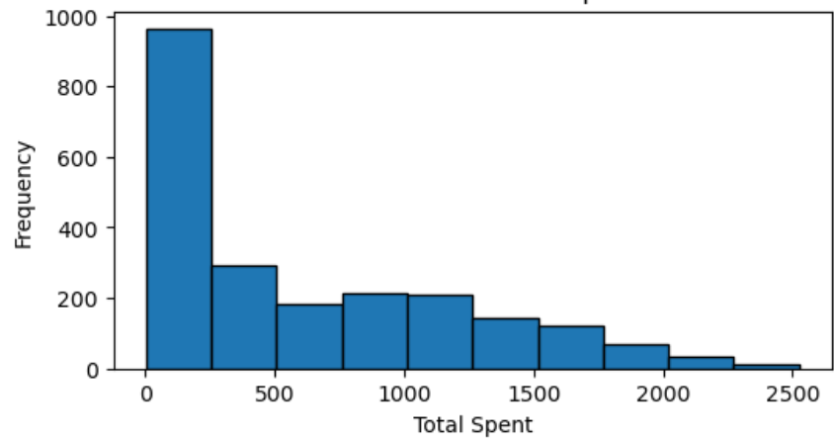
Data Cleaning & Pre-Processing
Missing Values
Outliers
Duplicates

Slide 5

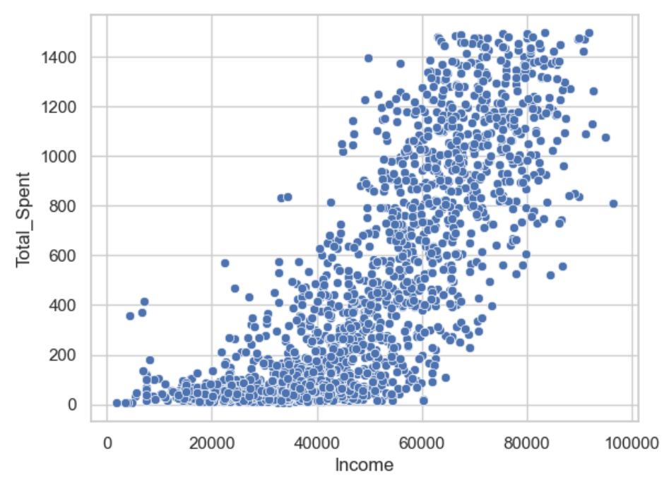
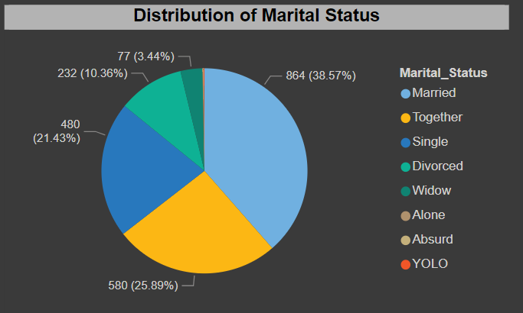
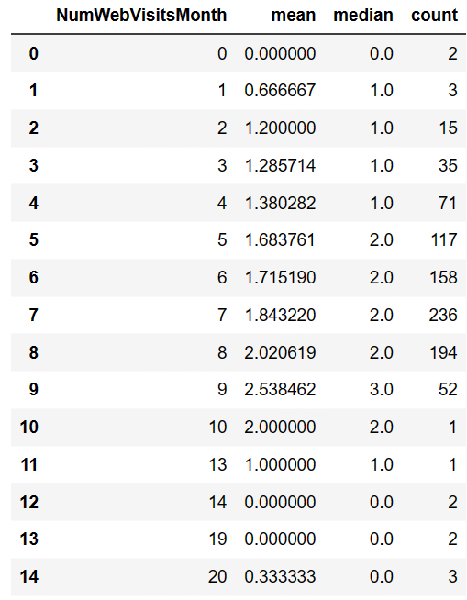
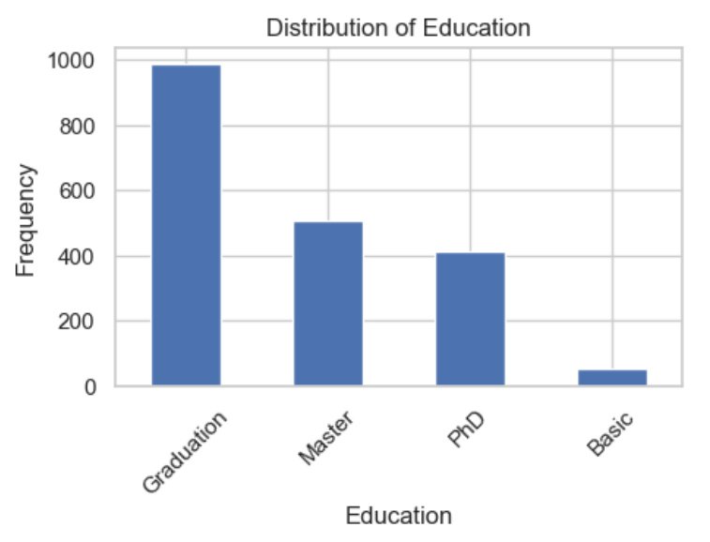
Summary Statistics
Total Spend
No of Purchases
Distribution of Customers

Slide 6

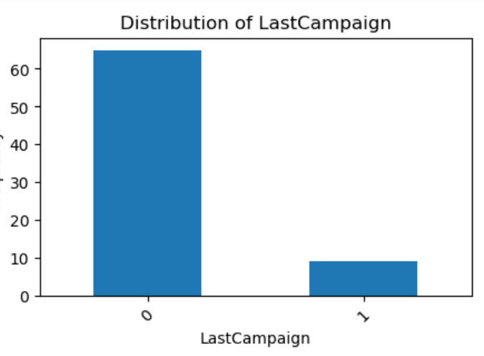
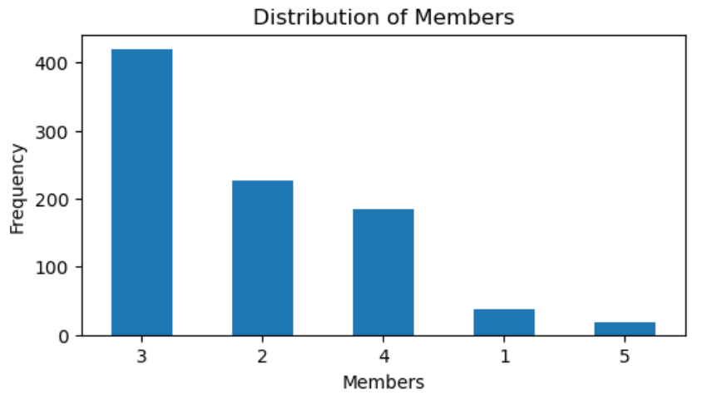
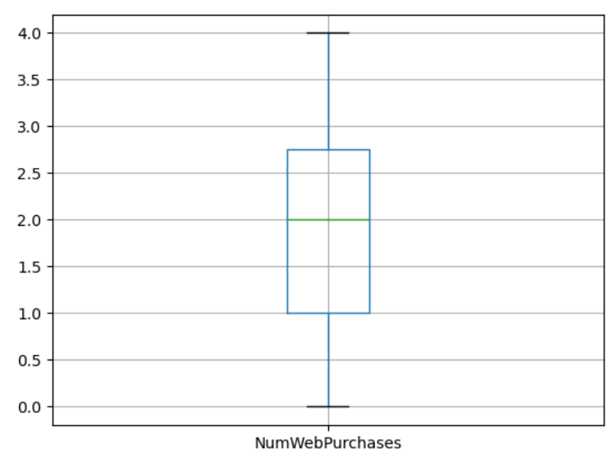
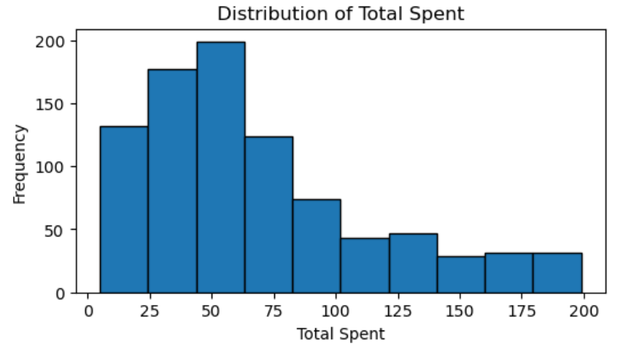
Univariate Analysis
Explanation
Histograms
Bar Plots

Slide 7

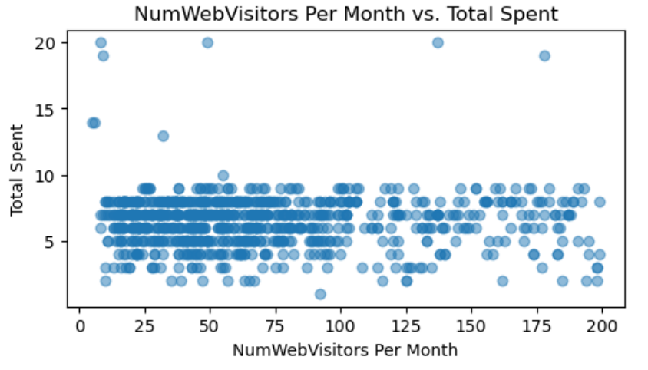
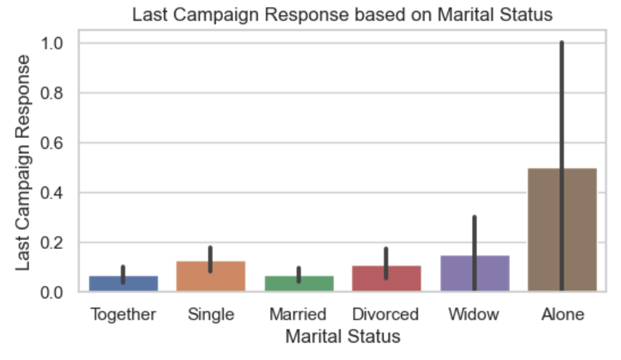
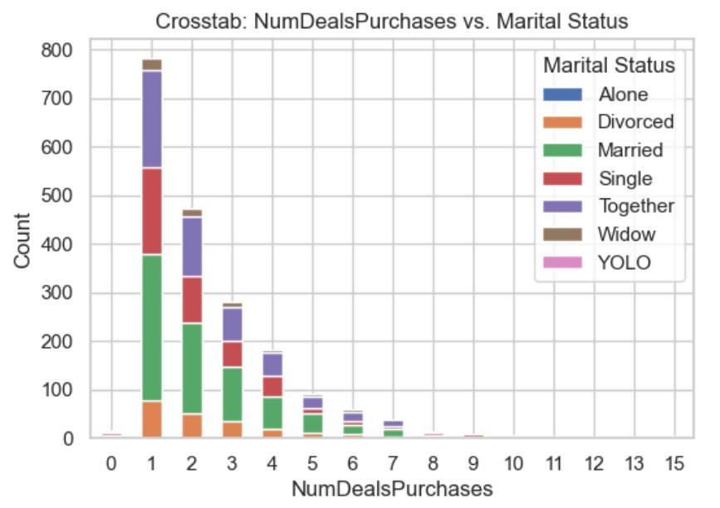
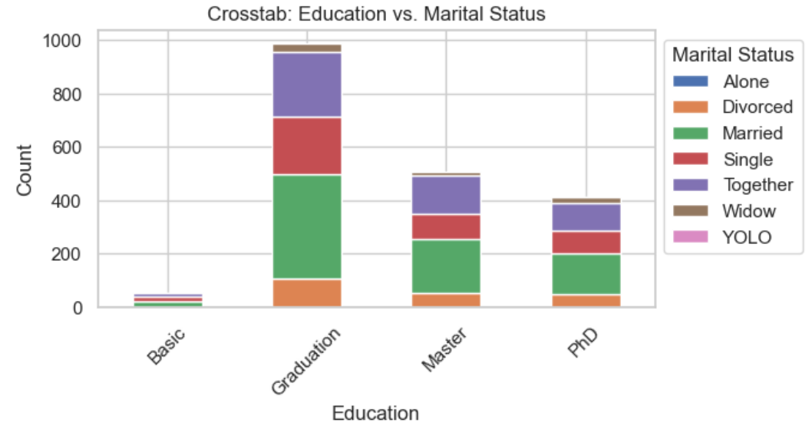
Bivariate Analysis
Explanation
Total Spent vs No of Visits
Education vs Marital Status

Slide 8
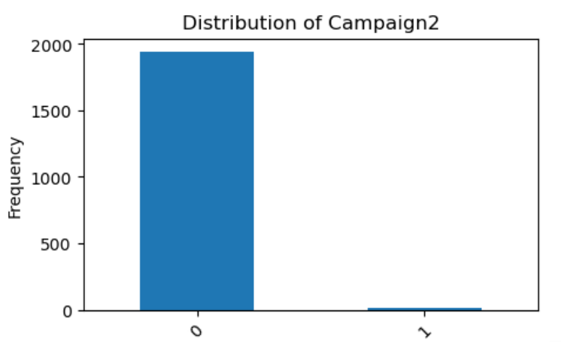
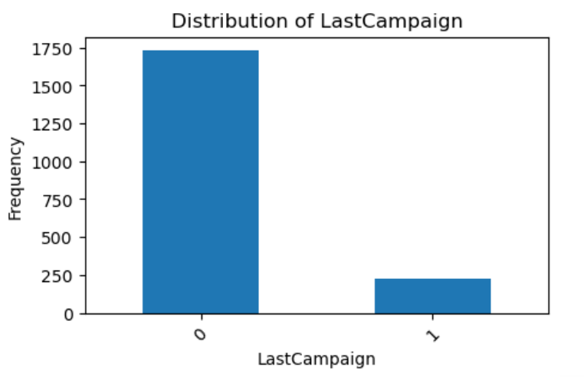
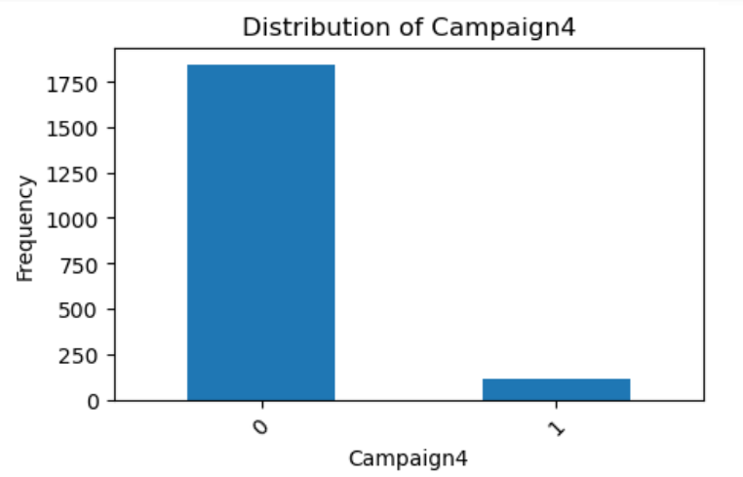
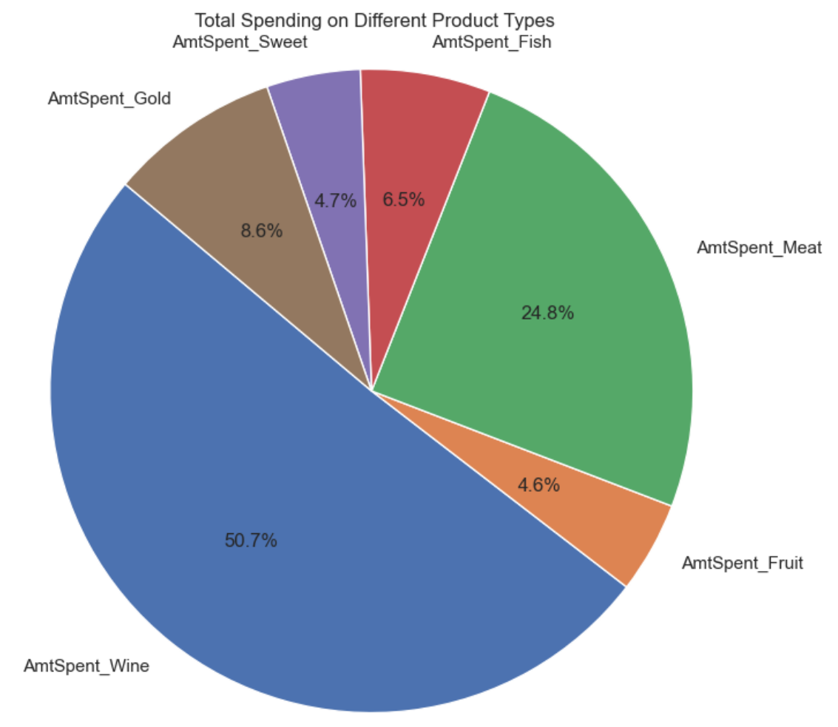
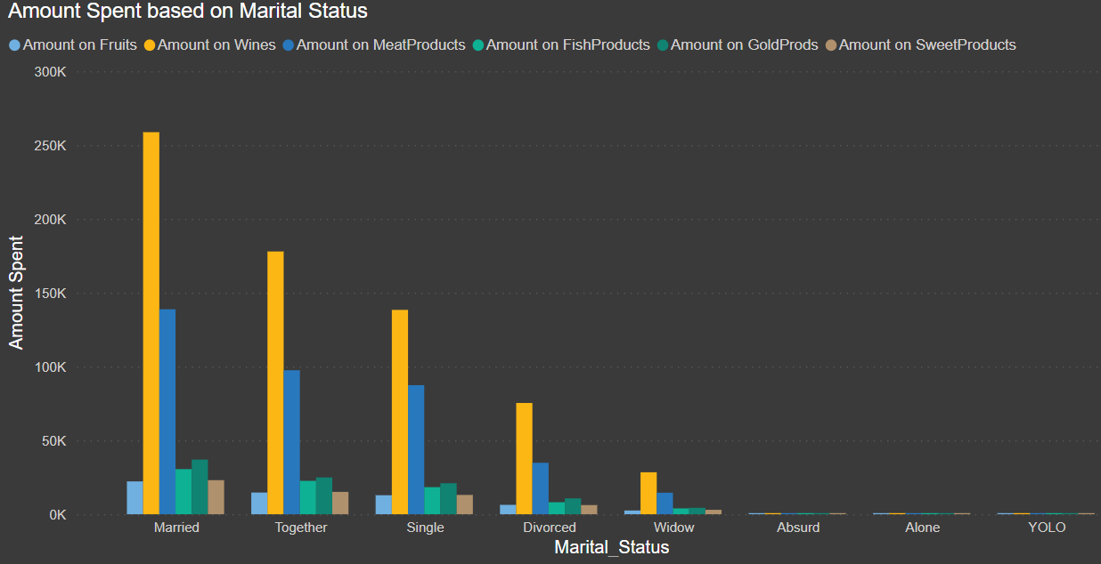
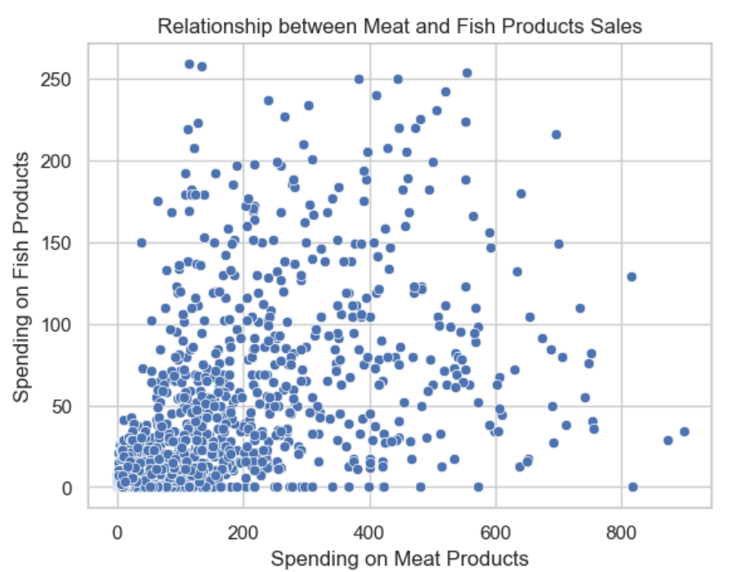
Insights and Findings
Key Insights
Relationships
Findings

Slide 9
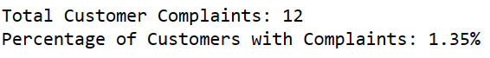
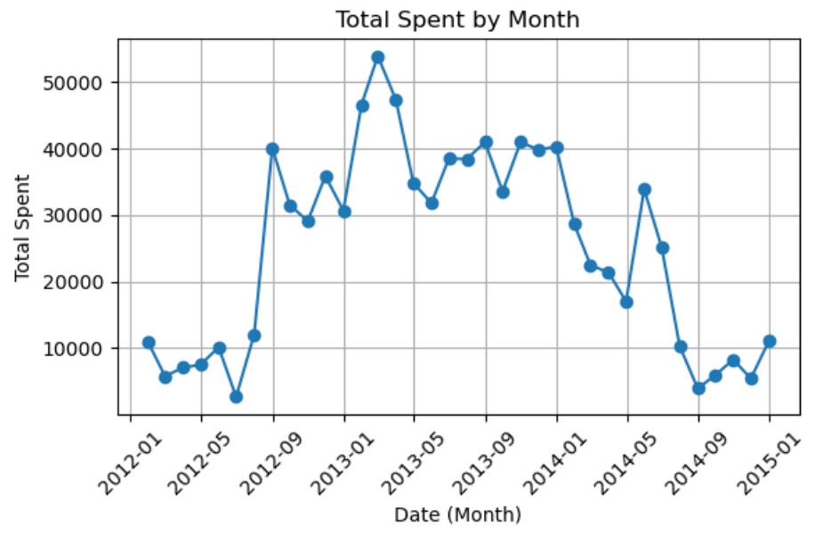
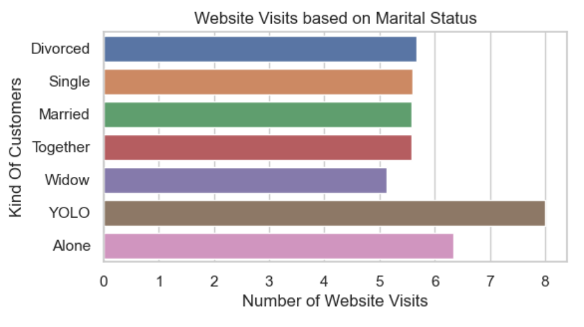
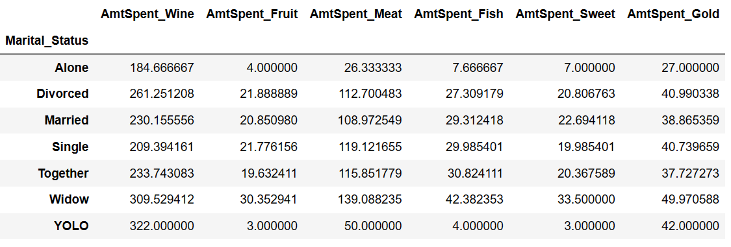
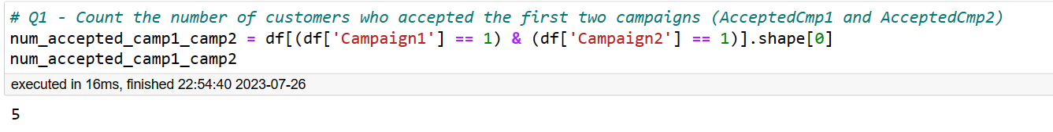
Business Questions
Questions Asked
Solutions

Slide 10


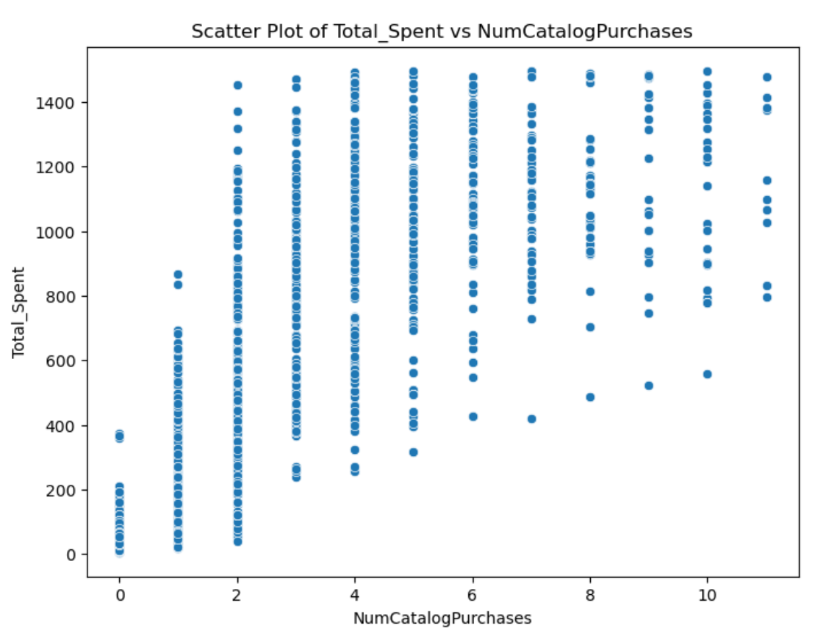
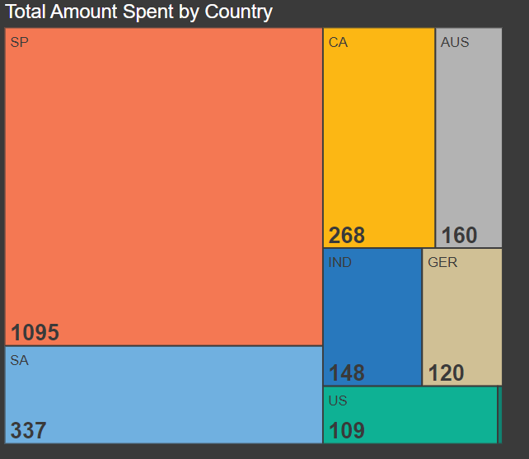
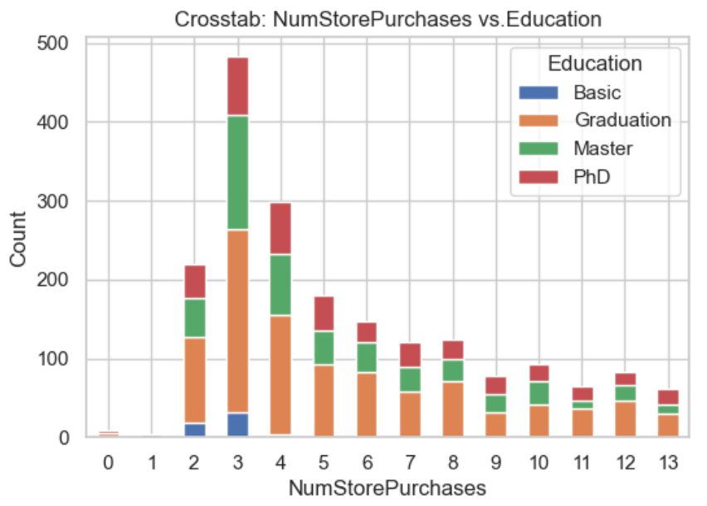
Recommendations
Customers with higher Num of Web-Visits Per Month
Sales Country-wise
In-store shopping Customers

Slide 11


Limitations
Acknowledgment of limitations :
i) Data may not represent the entire population
ii) External factors
iii) Market Segmentation
iv) Online Data Sources

Slide 12


Potential Areas for Further Research
Conduct surveys
Analyse competitors
Economic conditions
Time Spent

Slide 13



Conclusion
Valuable Analysis
Data-Driven
Stay Updated
Customer Satisfaction

Slide 14



